Slide 1
platos
platos.sdi.site
Intern/SDI

Slide 2
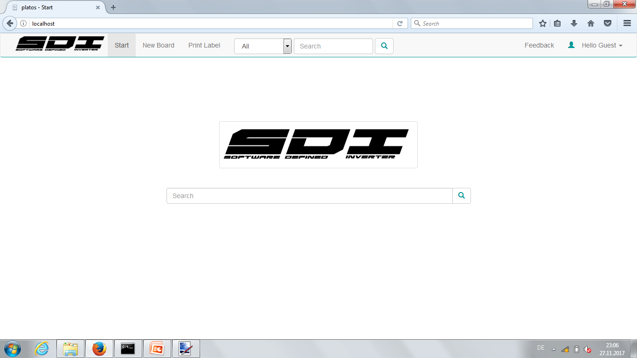
Start Page

Slide 3
Start Page

Slide 4
Log in

Slide 5
Login

Slide 6
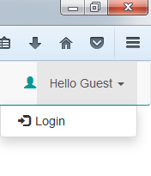
Login

Slide 7
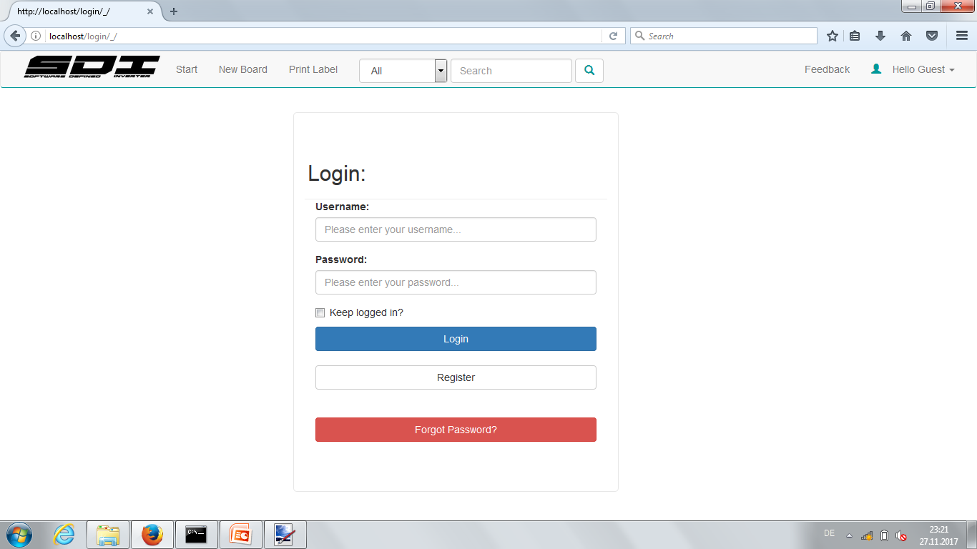
Login

Slide 8
Register

Slide 9
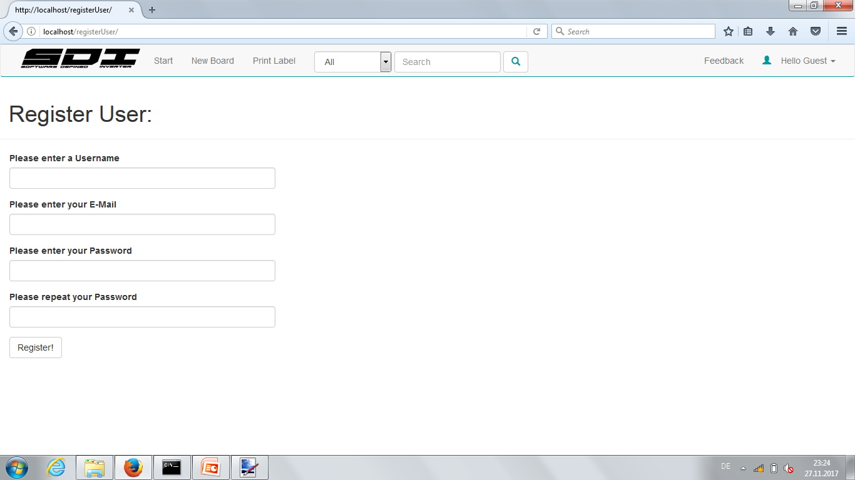
Register

Slide 10
Register
Warning:
Do not use the same password with any other service!
The password is saved encrypted but submitted via unencrypted HTTP protocol.

Slide 11
Register
MaxMustermann
maxmustermann@siemens.com
**********
**********

Slide 12
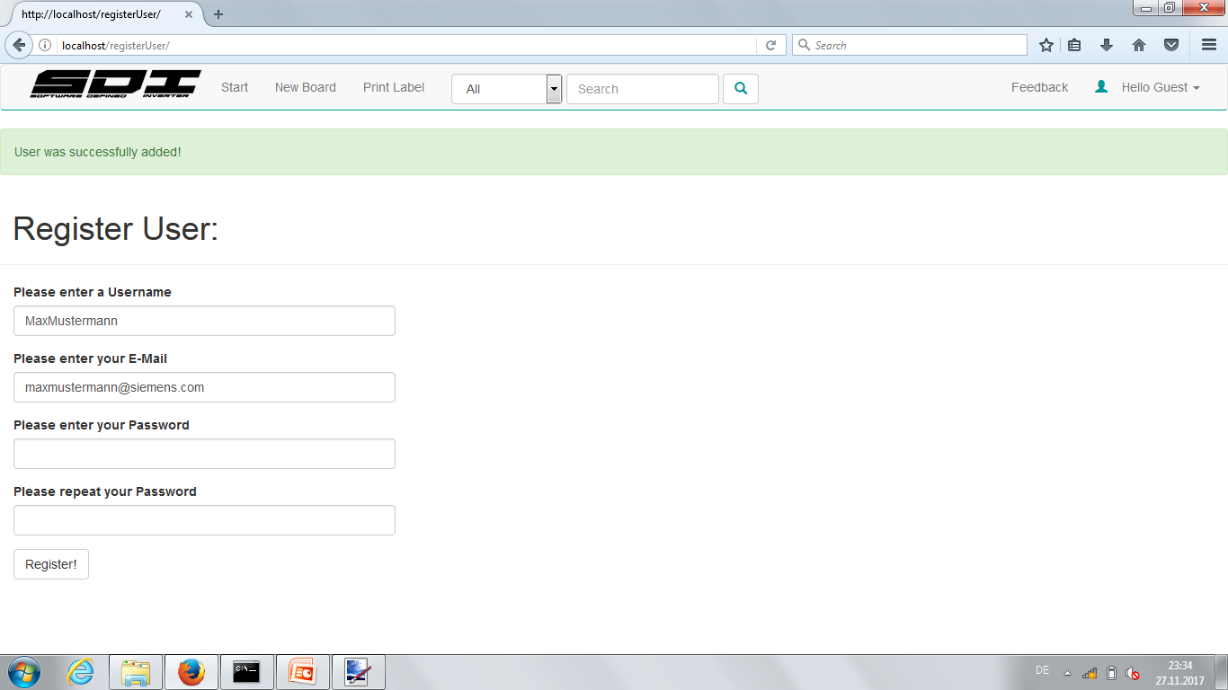
Register

Slide 13
Login

Slide 14
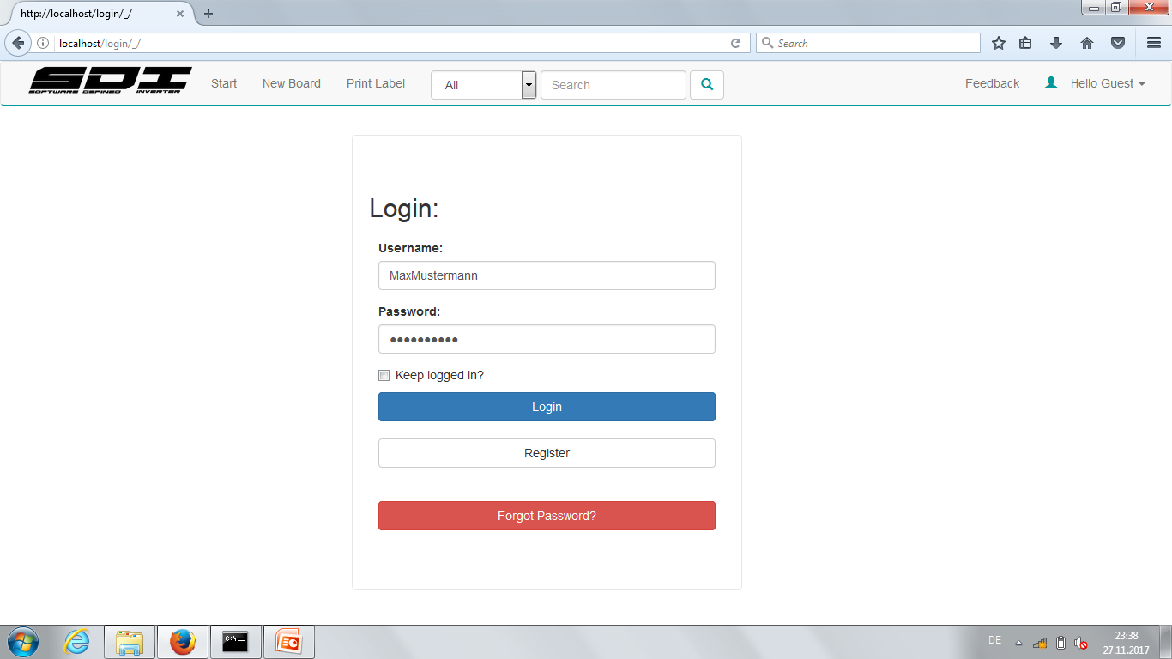
Login

Slide 15
Login

Slide 16
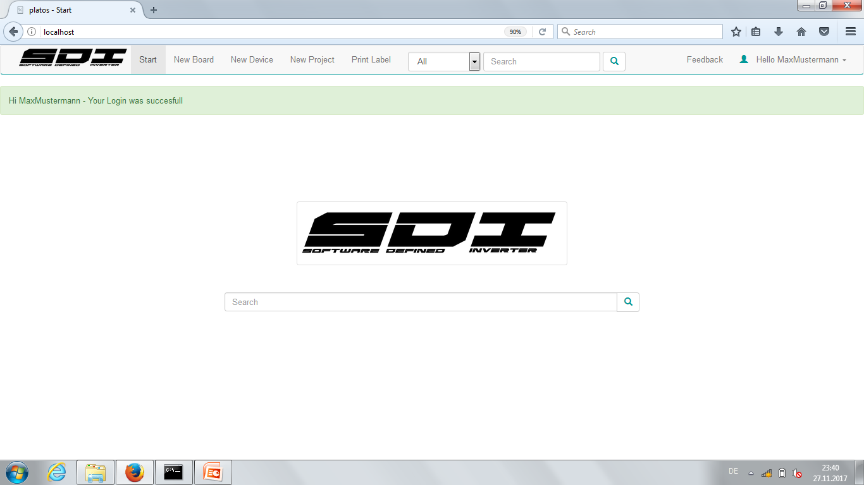
Login

Slide 17
Login

Slide 18
Login

Slide 19
Create a Project

Slide 20
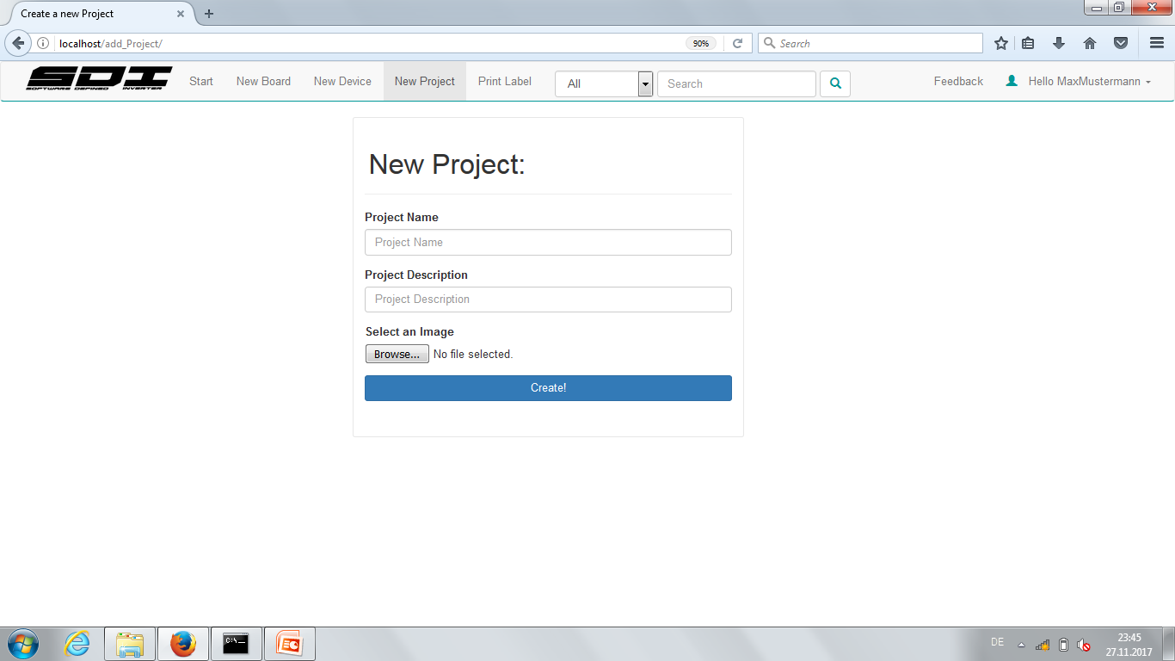
Create A Project

Slide 21
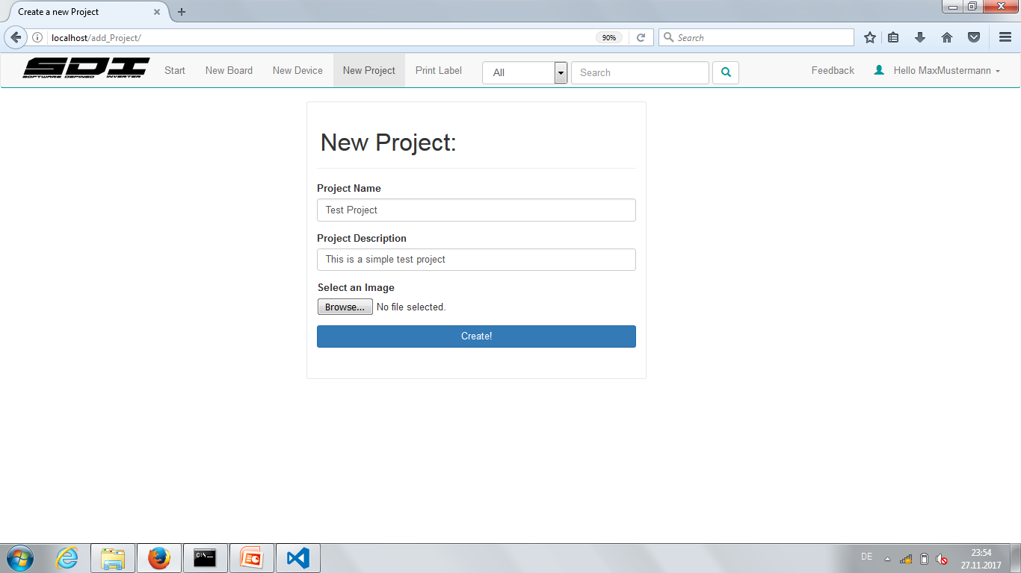
Create a Project

Slide 22
Create a Project

Slide 23
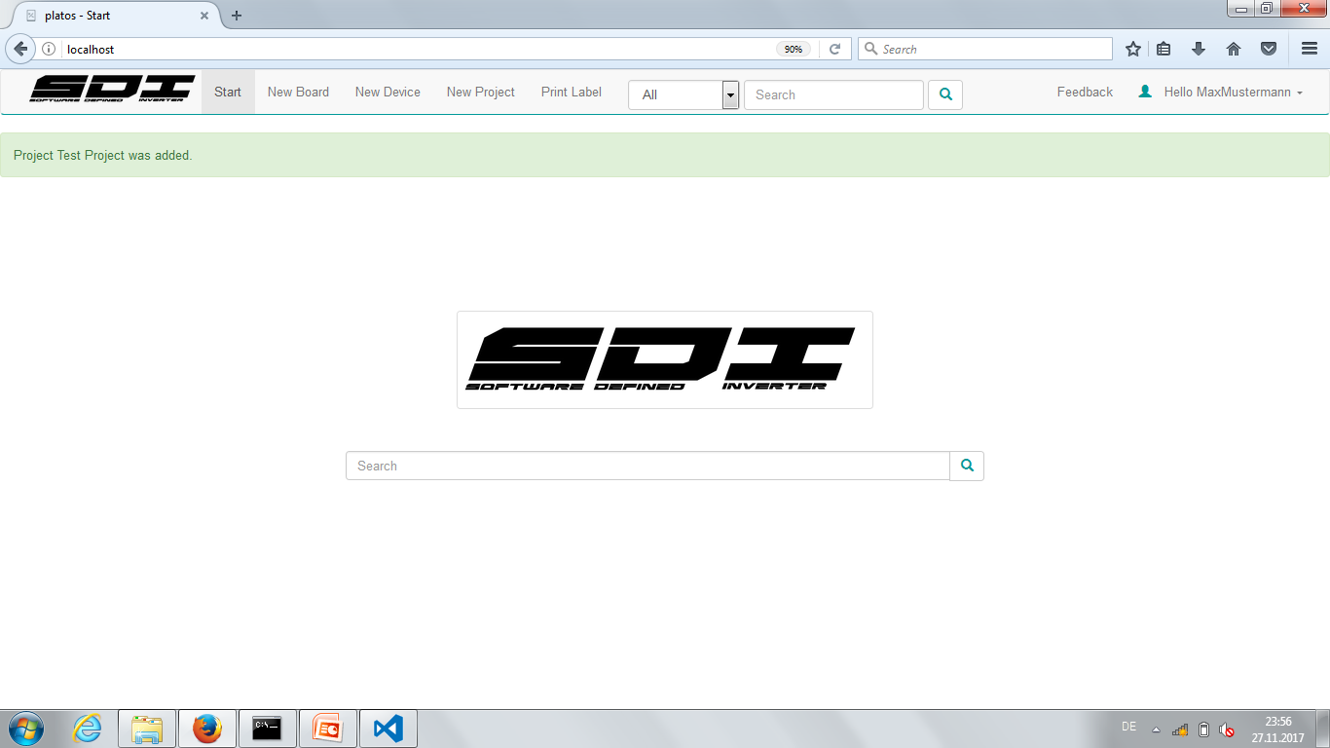
Create a Project

Slide 24
Create a Board

Slide 25
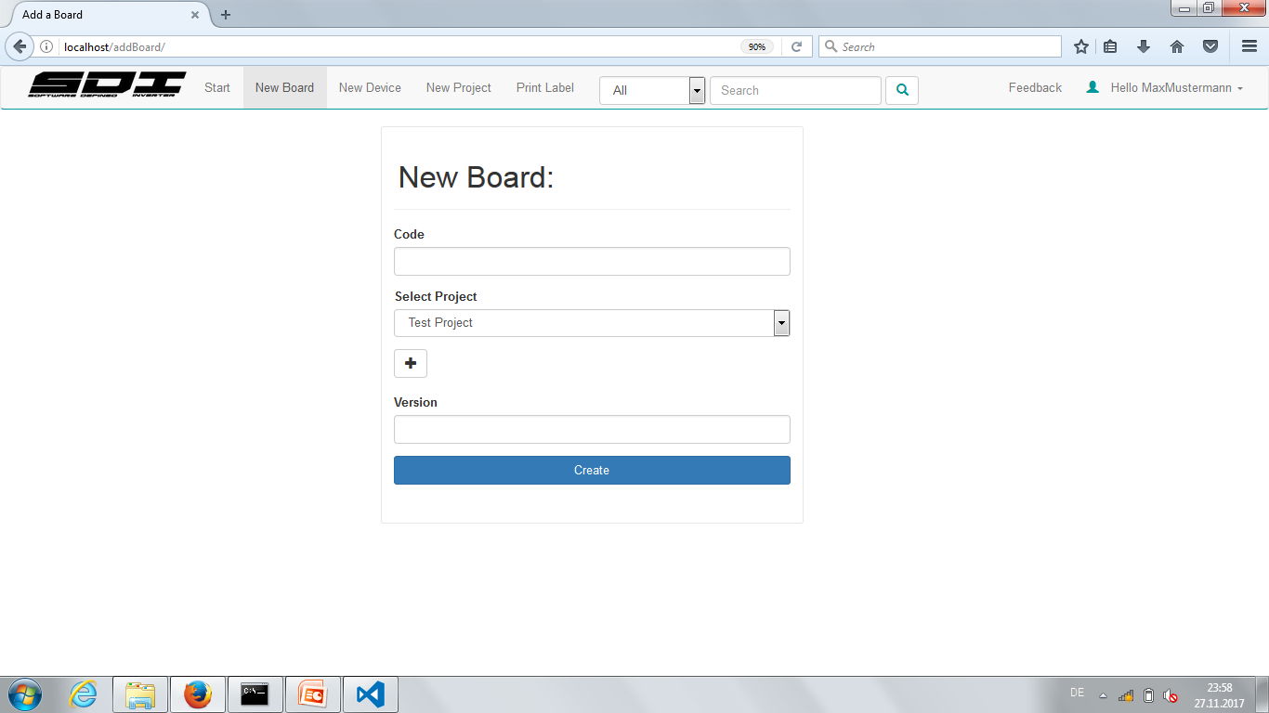
Create a Board

Slide 26

Create a Board

Slide 27
Interrupt – Create a Project

Slide 28
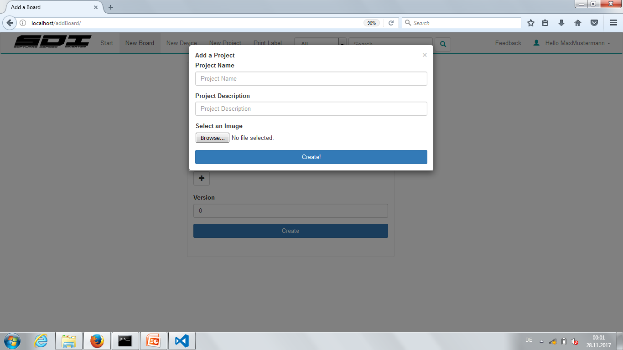
Interrupt - Create a Project

Slide 29
Create A Project

Slide 30
Interrupt - Create a Project

Slide 31
Create a Board

Slide 32
Create a Board

Slide 33
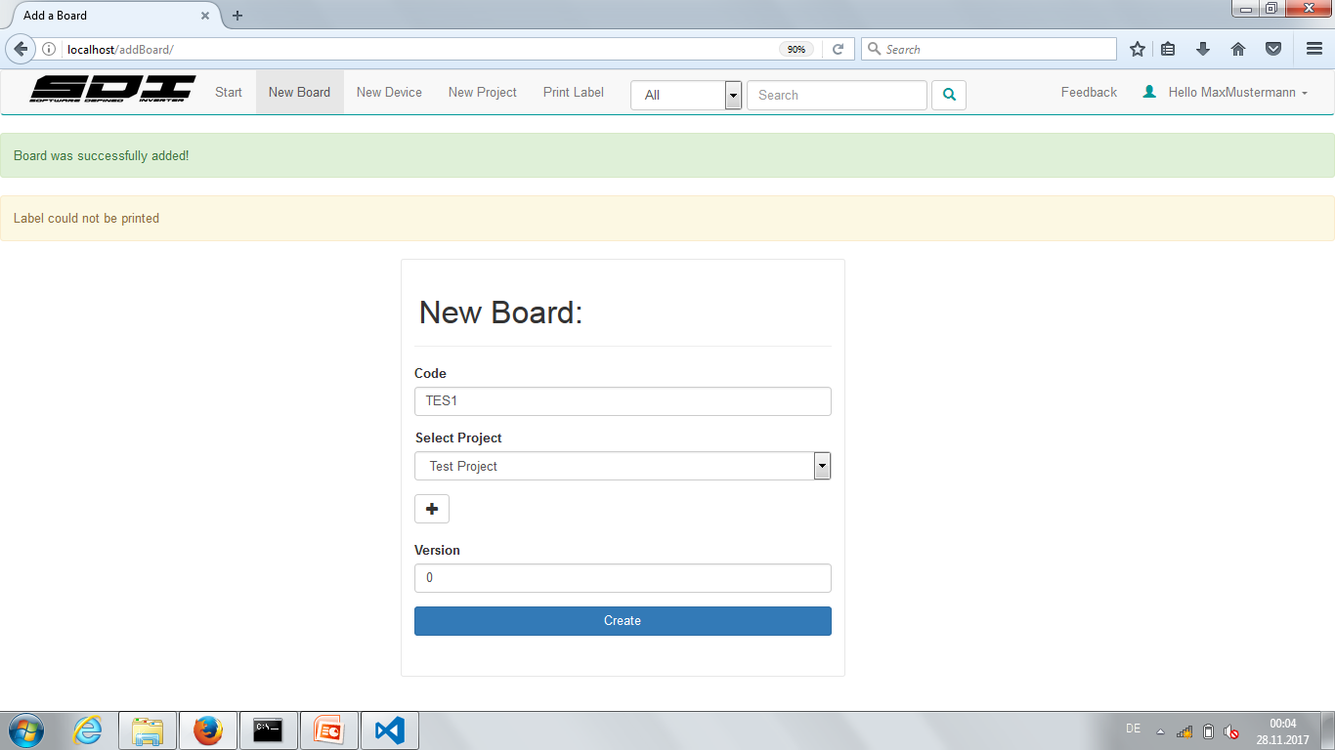
Create a Board

Slide 34
Create a Board

Slide 35
Create a Board - Label printer
Label printer is located in the storage room
Press the Feed button on the Printer once
Take the label
Apply label to the board
If printer says some error:
Press “pause” to ignore the error a few times, the label should be printed anyway

Slide 36
Searching stuff

Slide 37
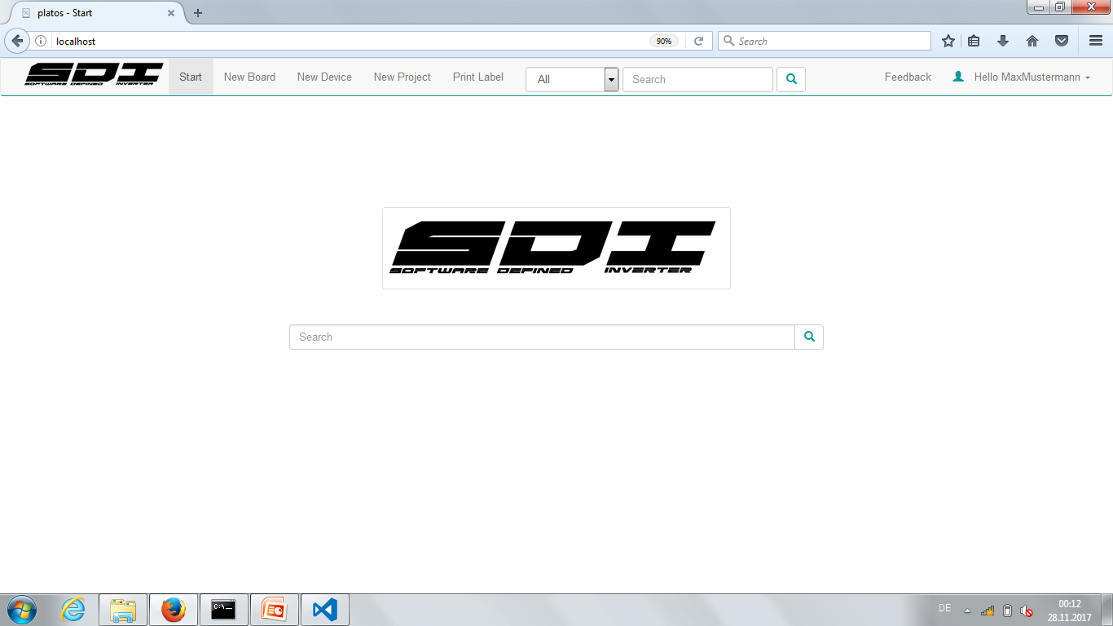
Searching

Slide 38
Searching

Slide 39
Searching - Options
Searching for attributes
[attribute_name]:[attribute_value]
-> test:passed <-
Soon:
Adding “and” rule to search
[first_rule]&[second_rule] (as much as you want)
-> owner:MaxMustermann&test:passed <-
-> Gridlink&state:working <-

Slide 40
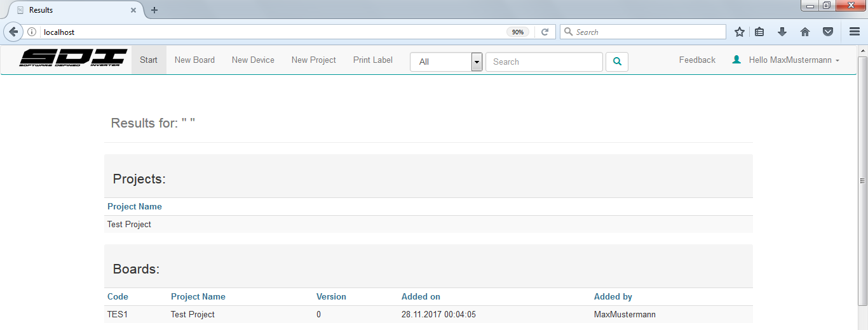
Empty search

Slide 41
Search

Slide 42
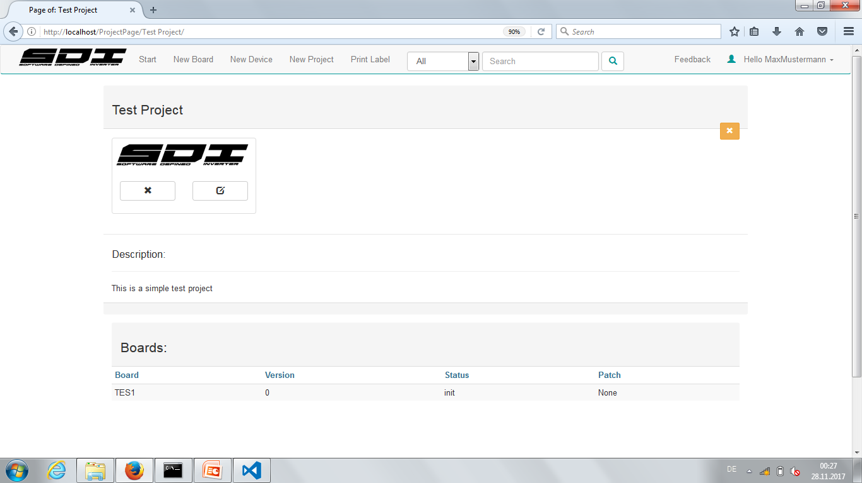
Project Page

Slide 43
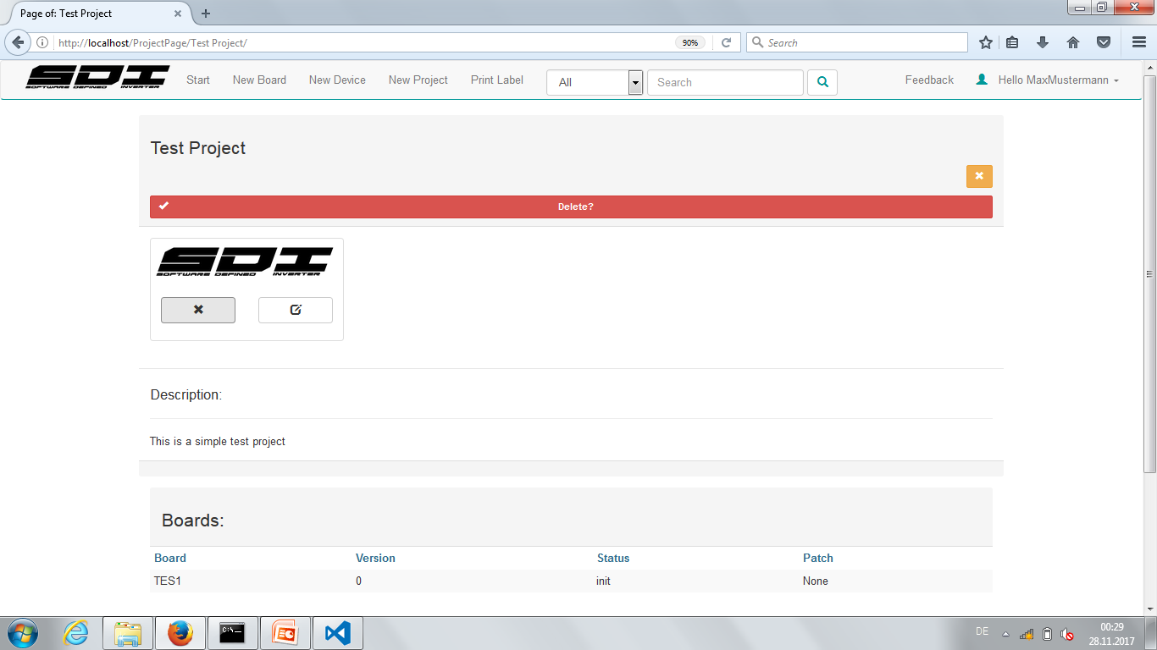
Project Page

Slide 44
Project Page

Slide 45
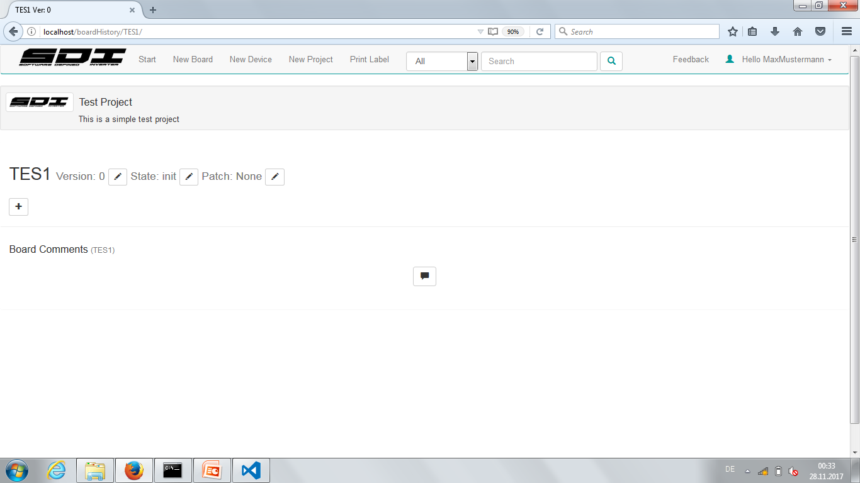
Board Page

Slide 46
Board Page

Slide 47
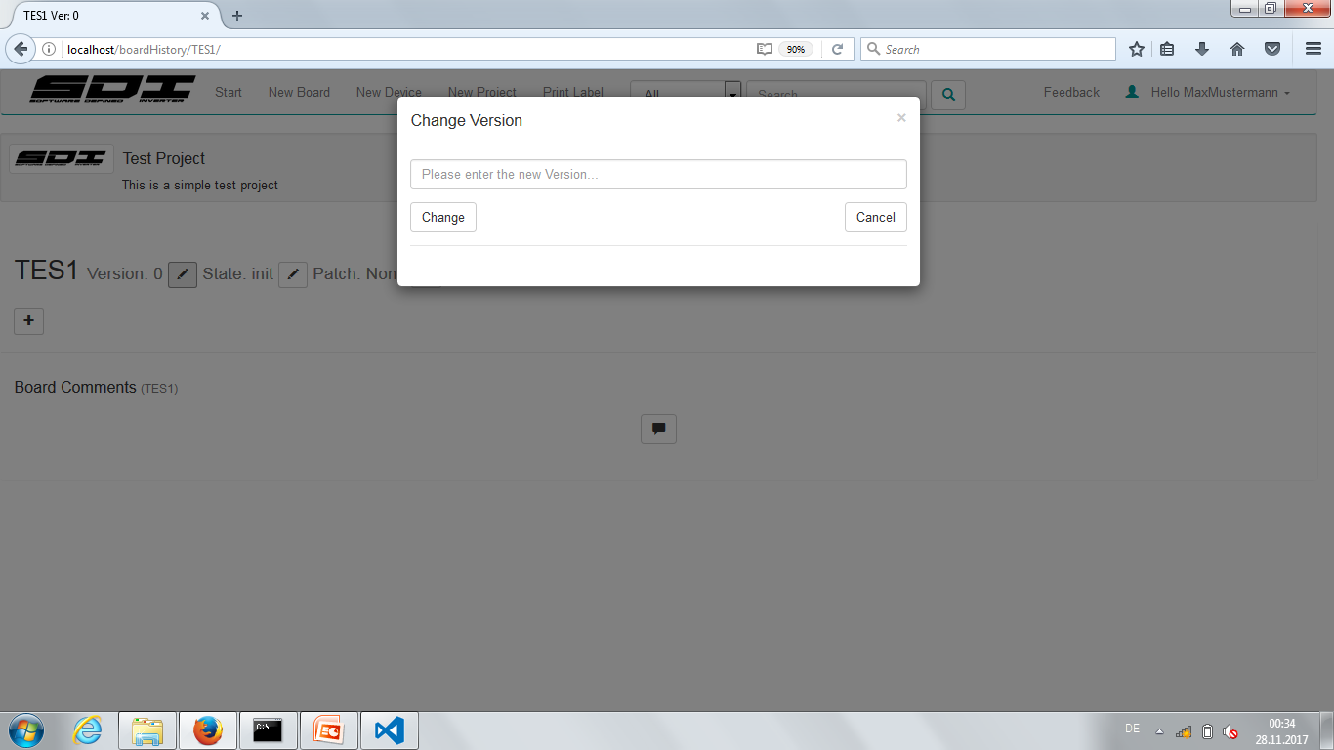

Edit Attributes

Slide 48

Edit Attributes

Slide 49
Edit Attributes

Slide 50
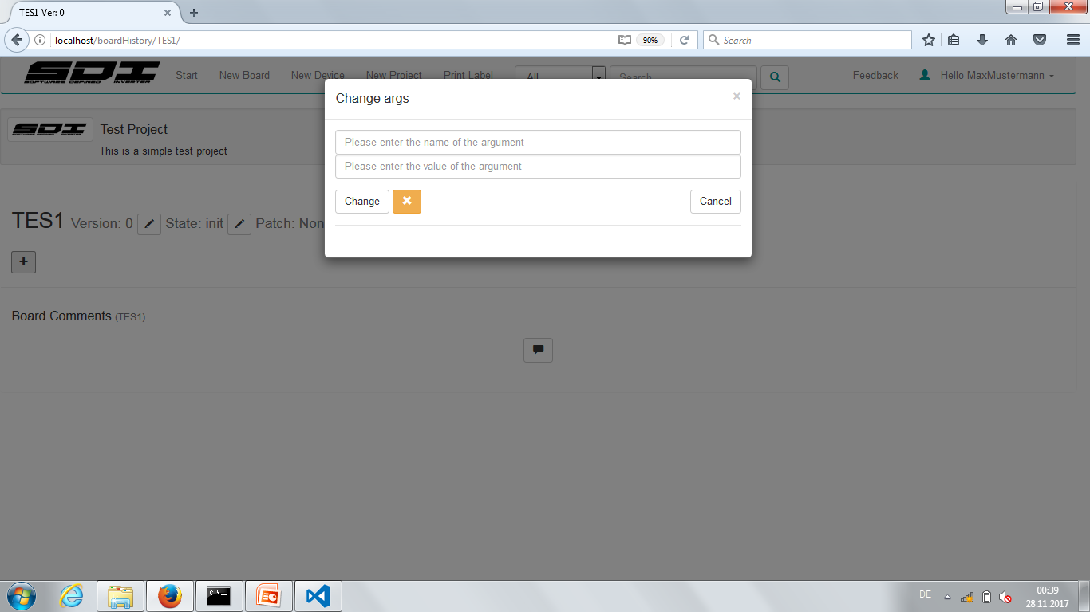
Edit Attributes

Slide 51
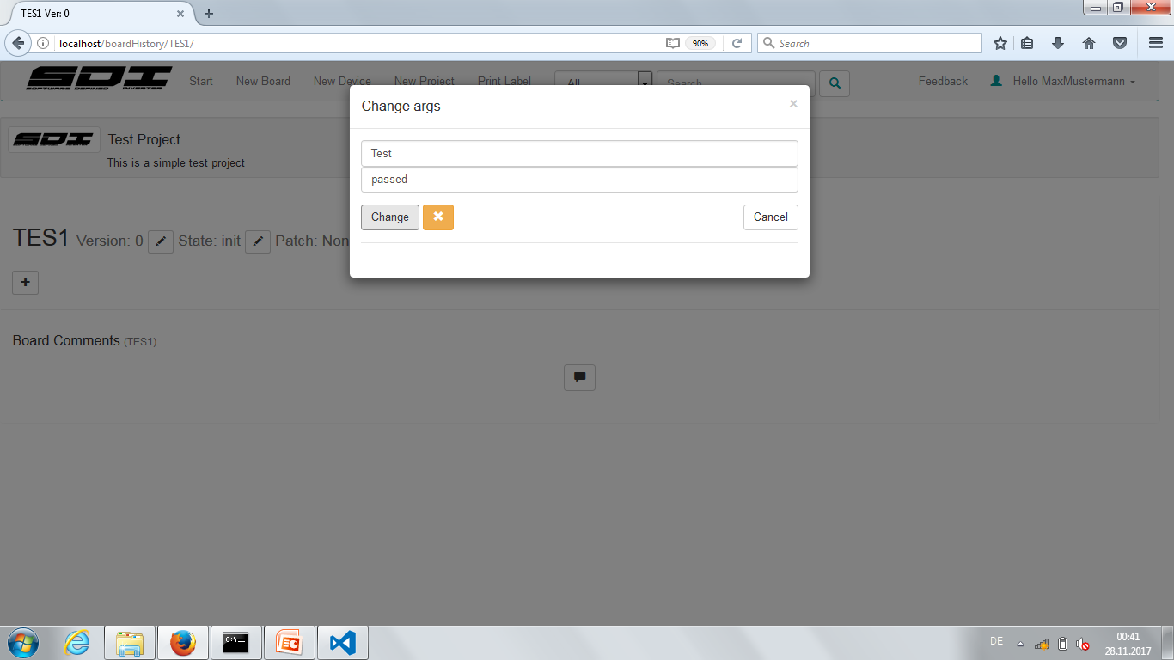
Edit Attributes

Slide 52
Edit Attributes

Slide 53
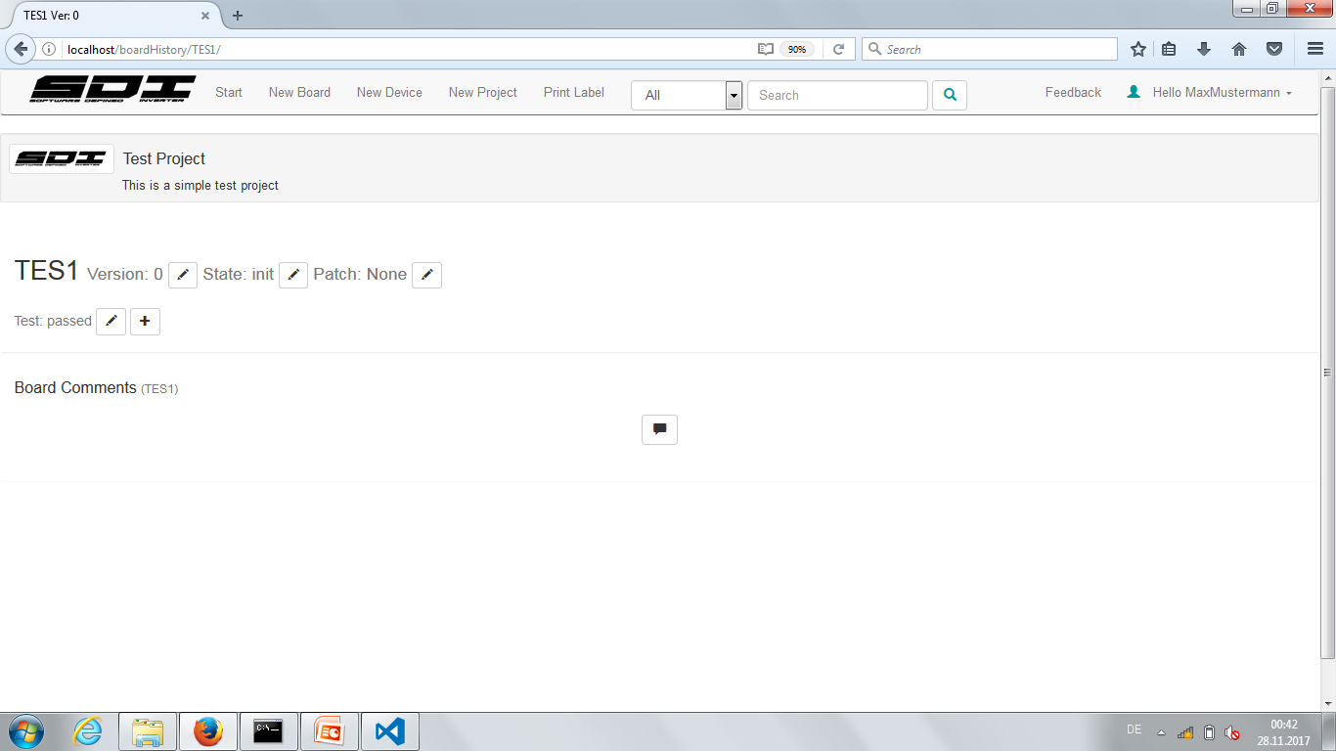
Edit Attributes

Slide 54
Edit Attributes

Slide 55

Edit Attributes

Slide 56
Edit Attributes

Slide 57

Edit Attributes

Slide 58
Add Comments

Slide 59
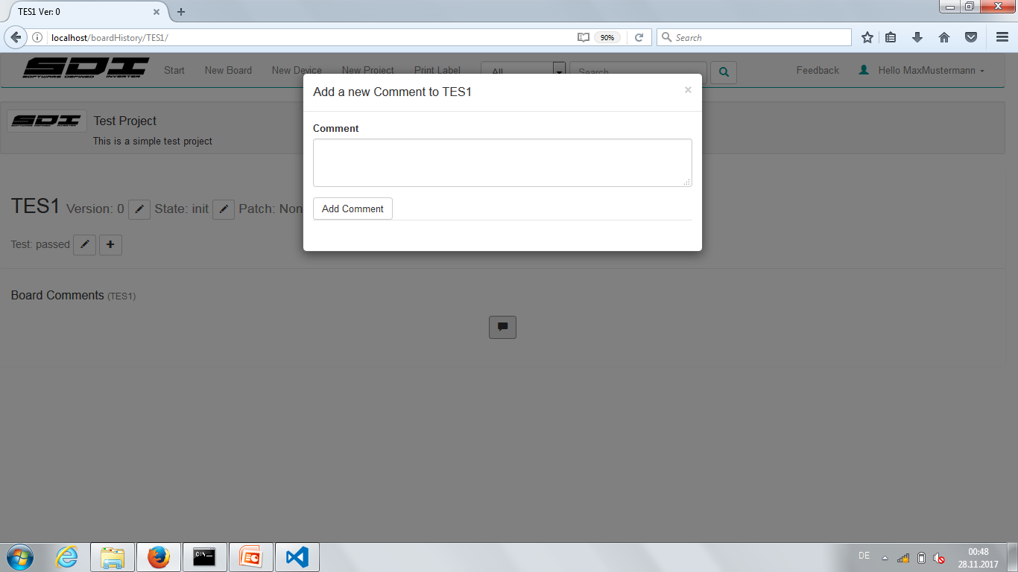
Add Comments

Slide 60
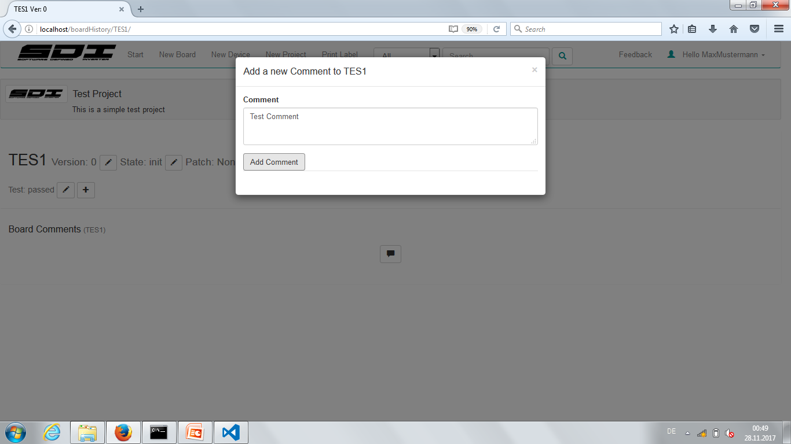
Add Comments

Slide 61
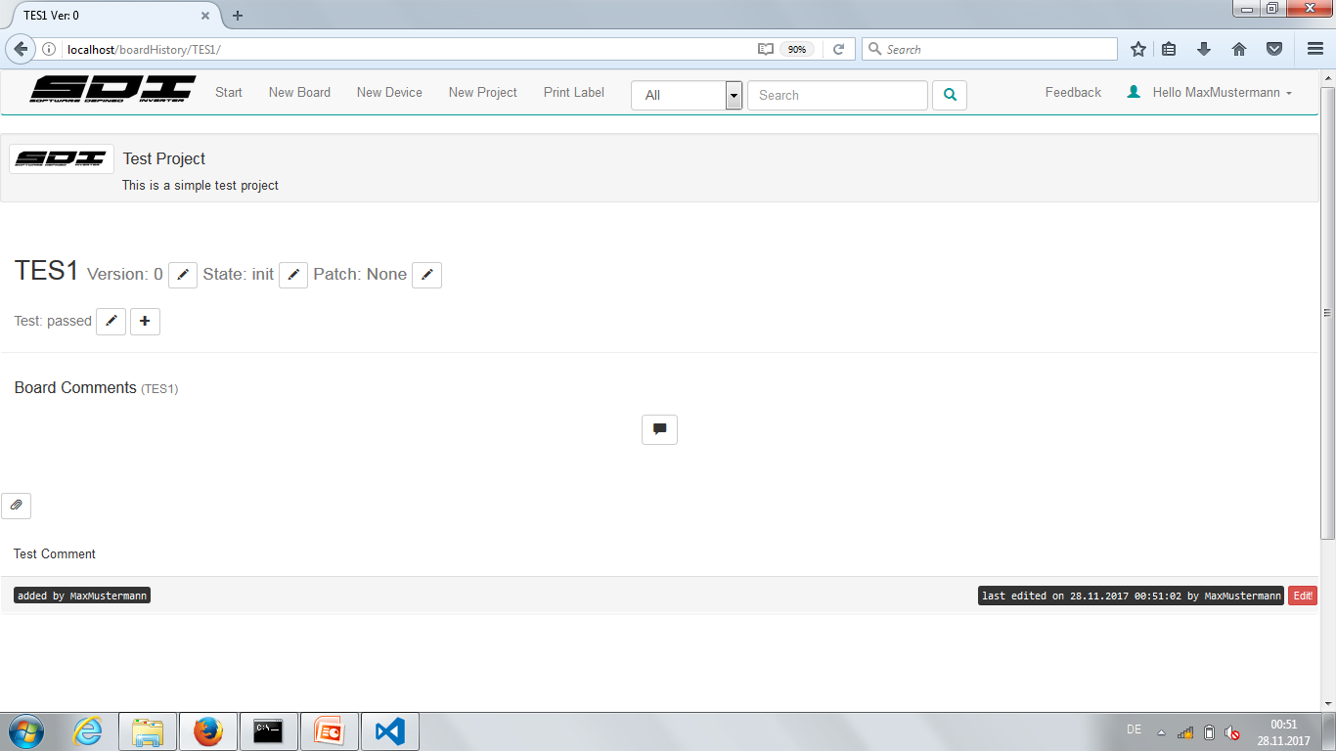
Add Comments

Slide 62
Add Pictures/Edit Comment

Slide 63
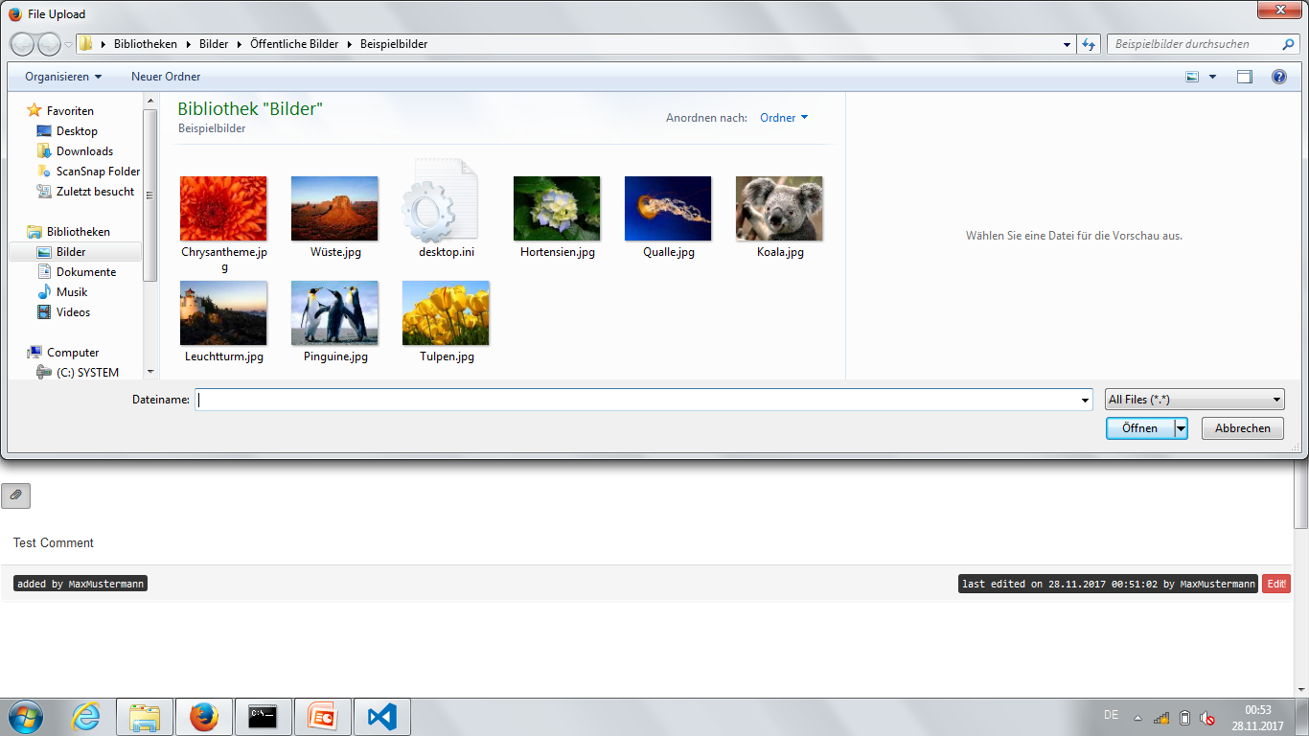
Add Pictures/Edit Comment

Slide 64
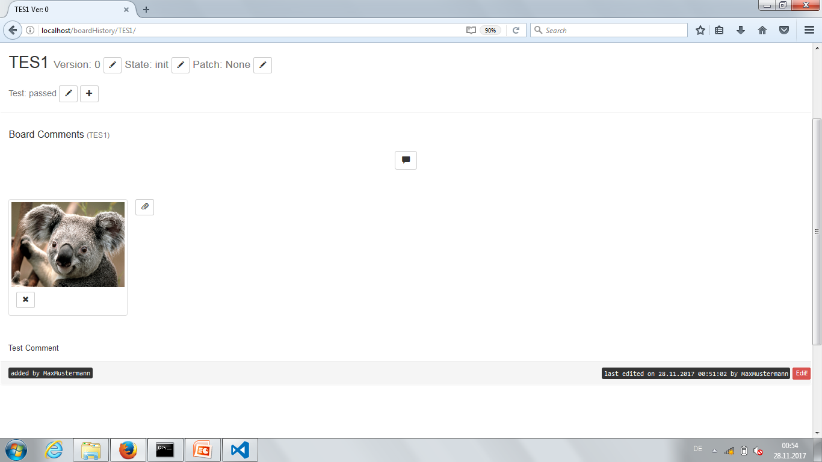
Add Pictures/Edit Comment

Slide 65
Add Pictures/Edit Comment

Slide 66
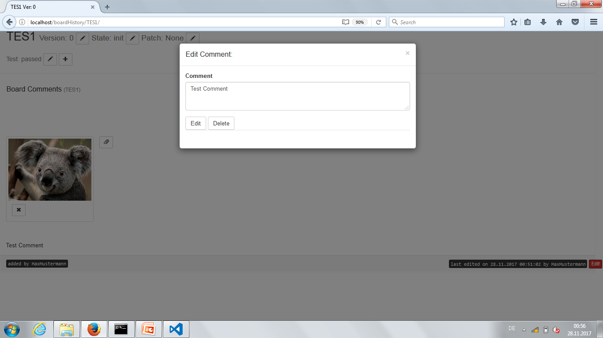
Add Pictures/Edit Comment

Slide 67

Feedback/Feature Requests

Slide 68
Feedback/Feature Requests
Provide feedback and feature requests to:
stefan.steinmueller@siemens.com

Slide 69
Stefan Steinmüller Working Student CT REE SDI
Frauenauracher Str. 80 91056 Erlangen
E-mail: stefan.steinmueller@siemens.com

